Slide 1
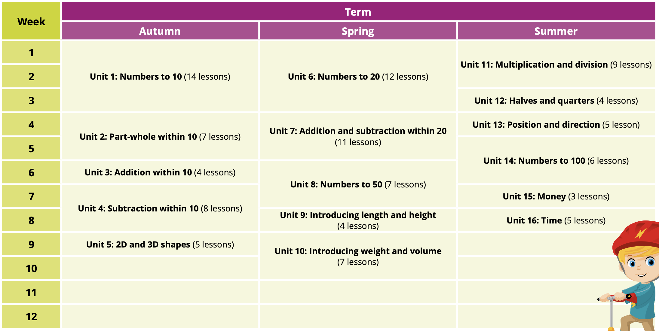
Y1 2025 - 2026
Maths Curriculum Overview

Slide 2
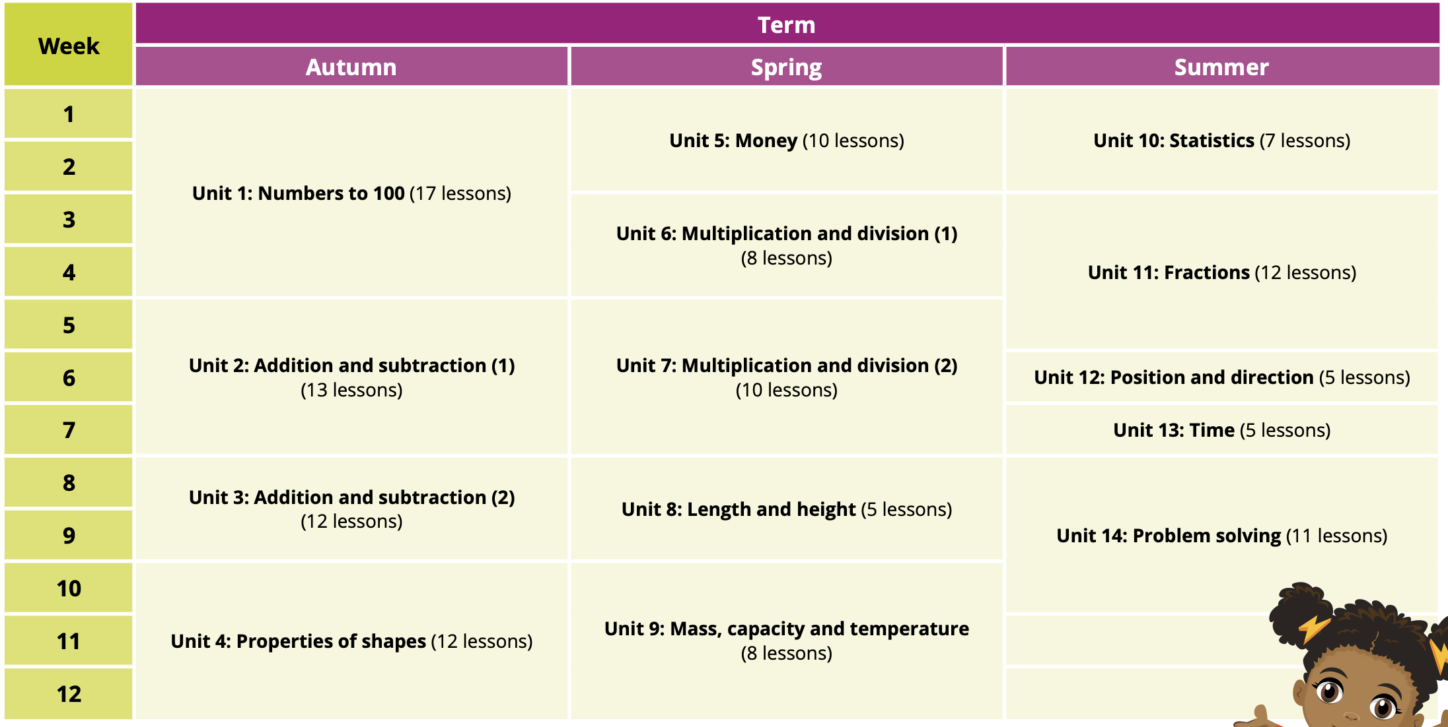
Y2 2025 - 2026
Maths Curriculum Overview

Slide 3
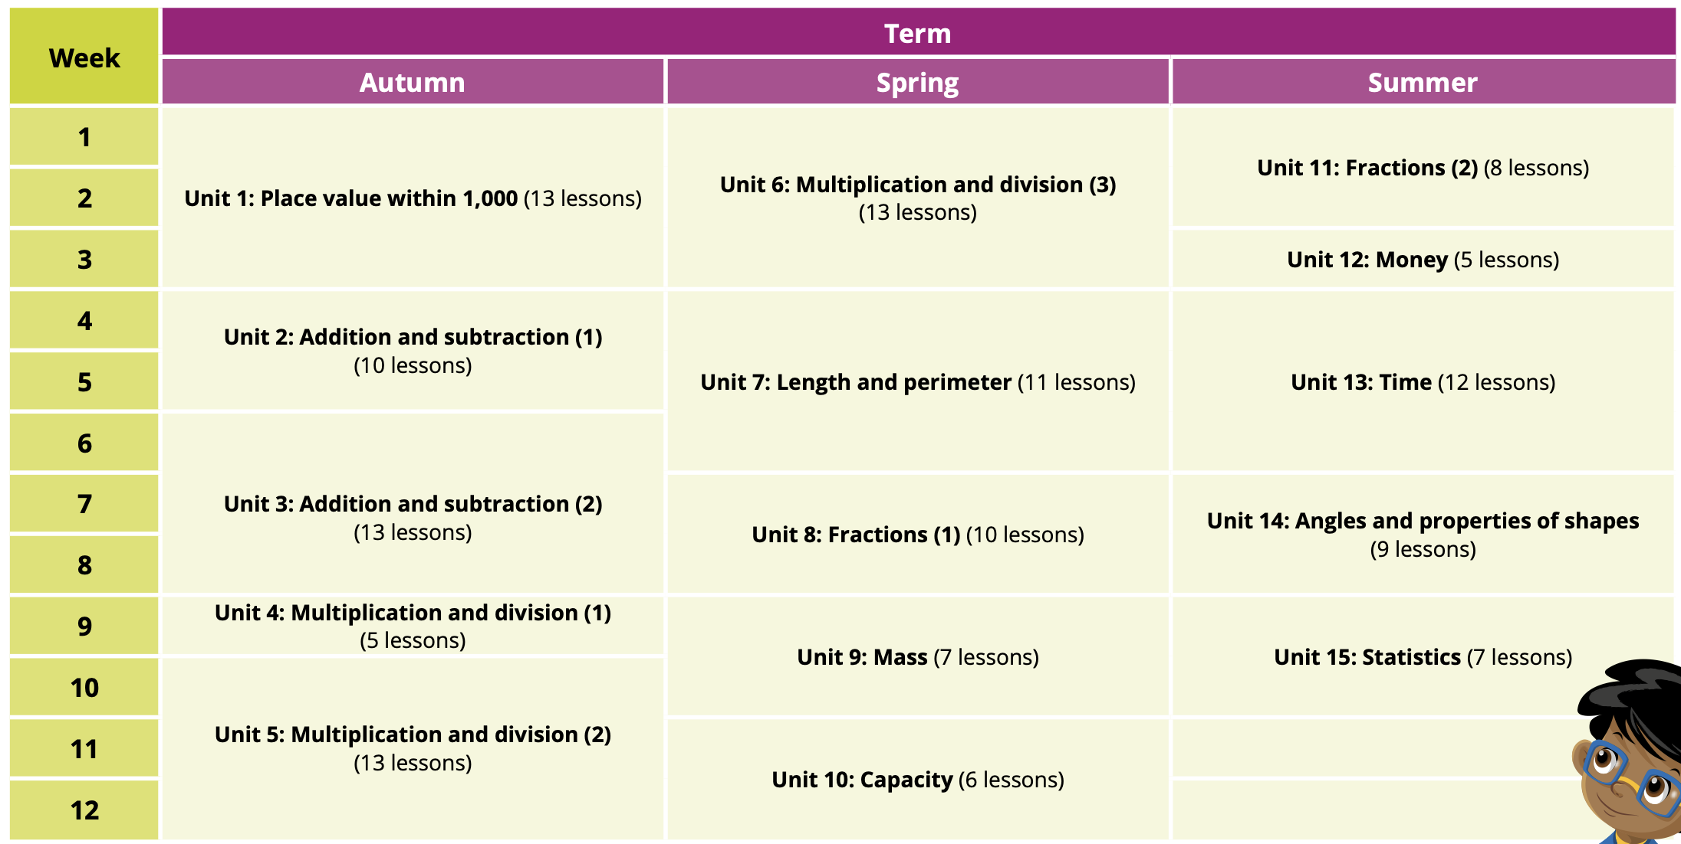
Y3 2025 - 2026
Maths Curriculum Overview

Slide 4
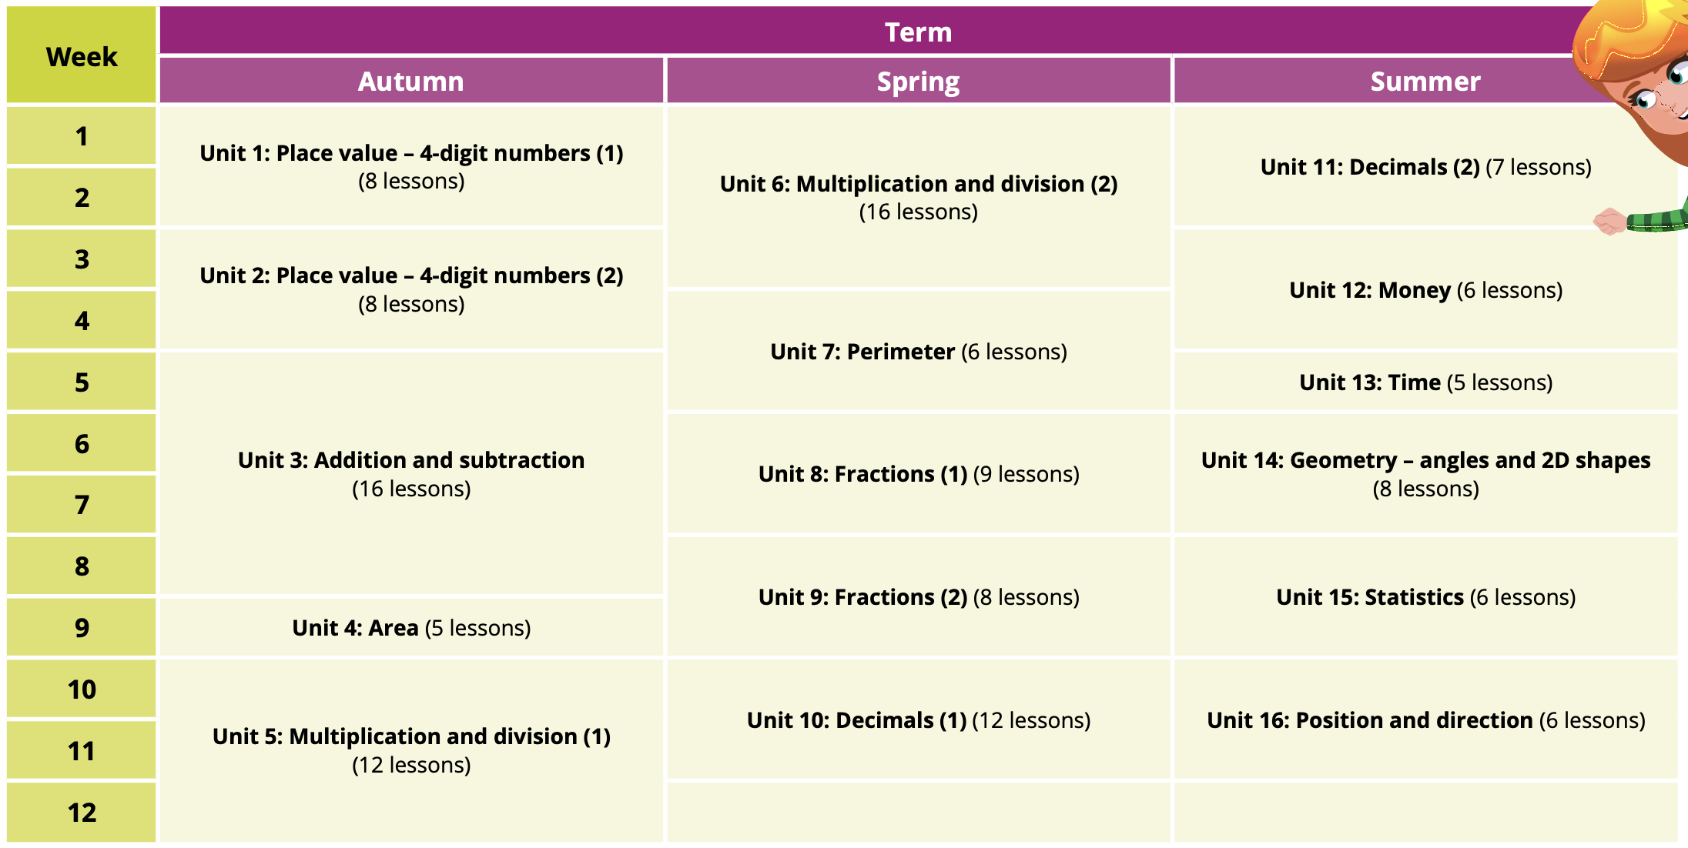
Y4 2025 - 2026
Maths Curriculum Overview

Slide 5
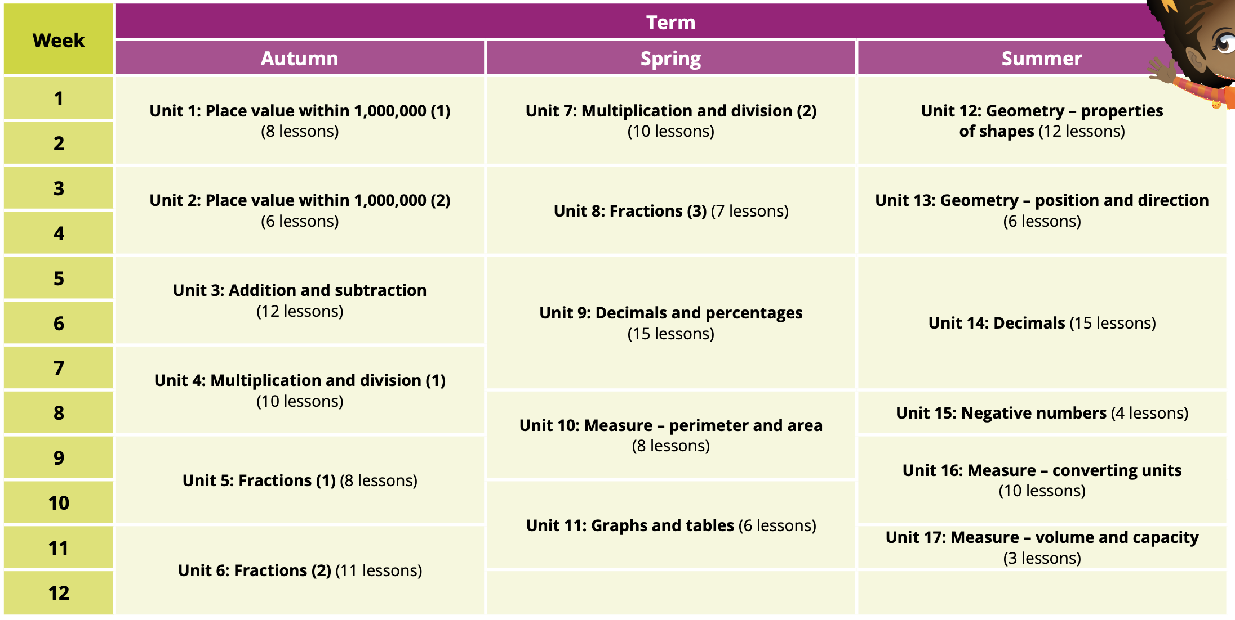
Y5 2025 - 2026
Maths Curriculum Overview

Slide 6
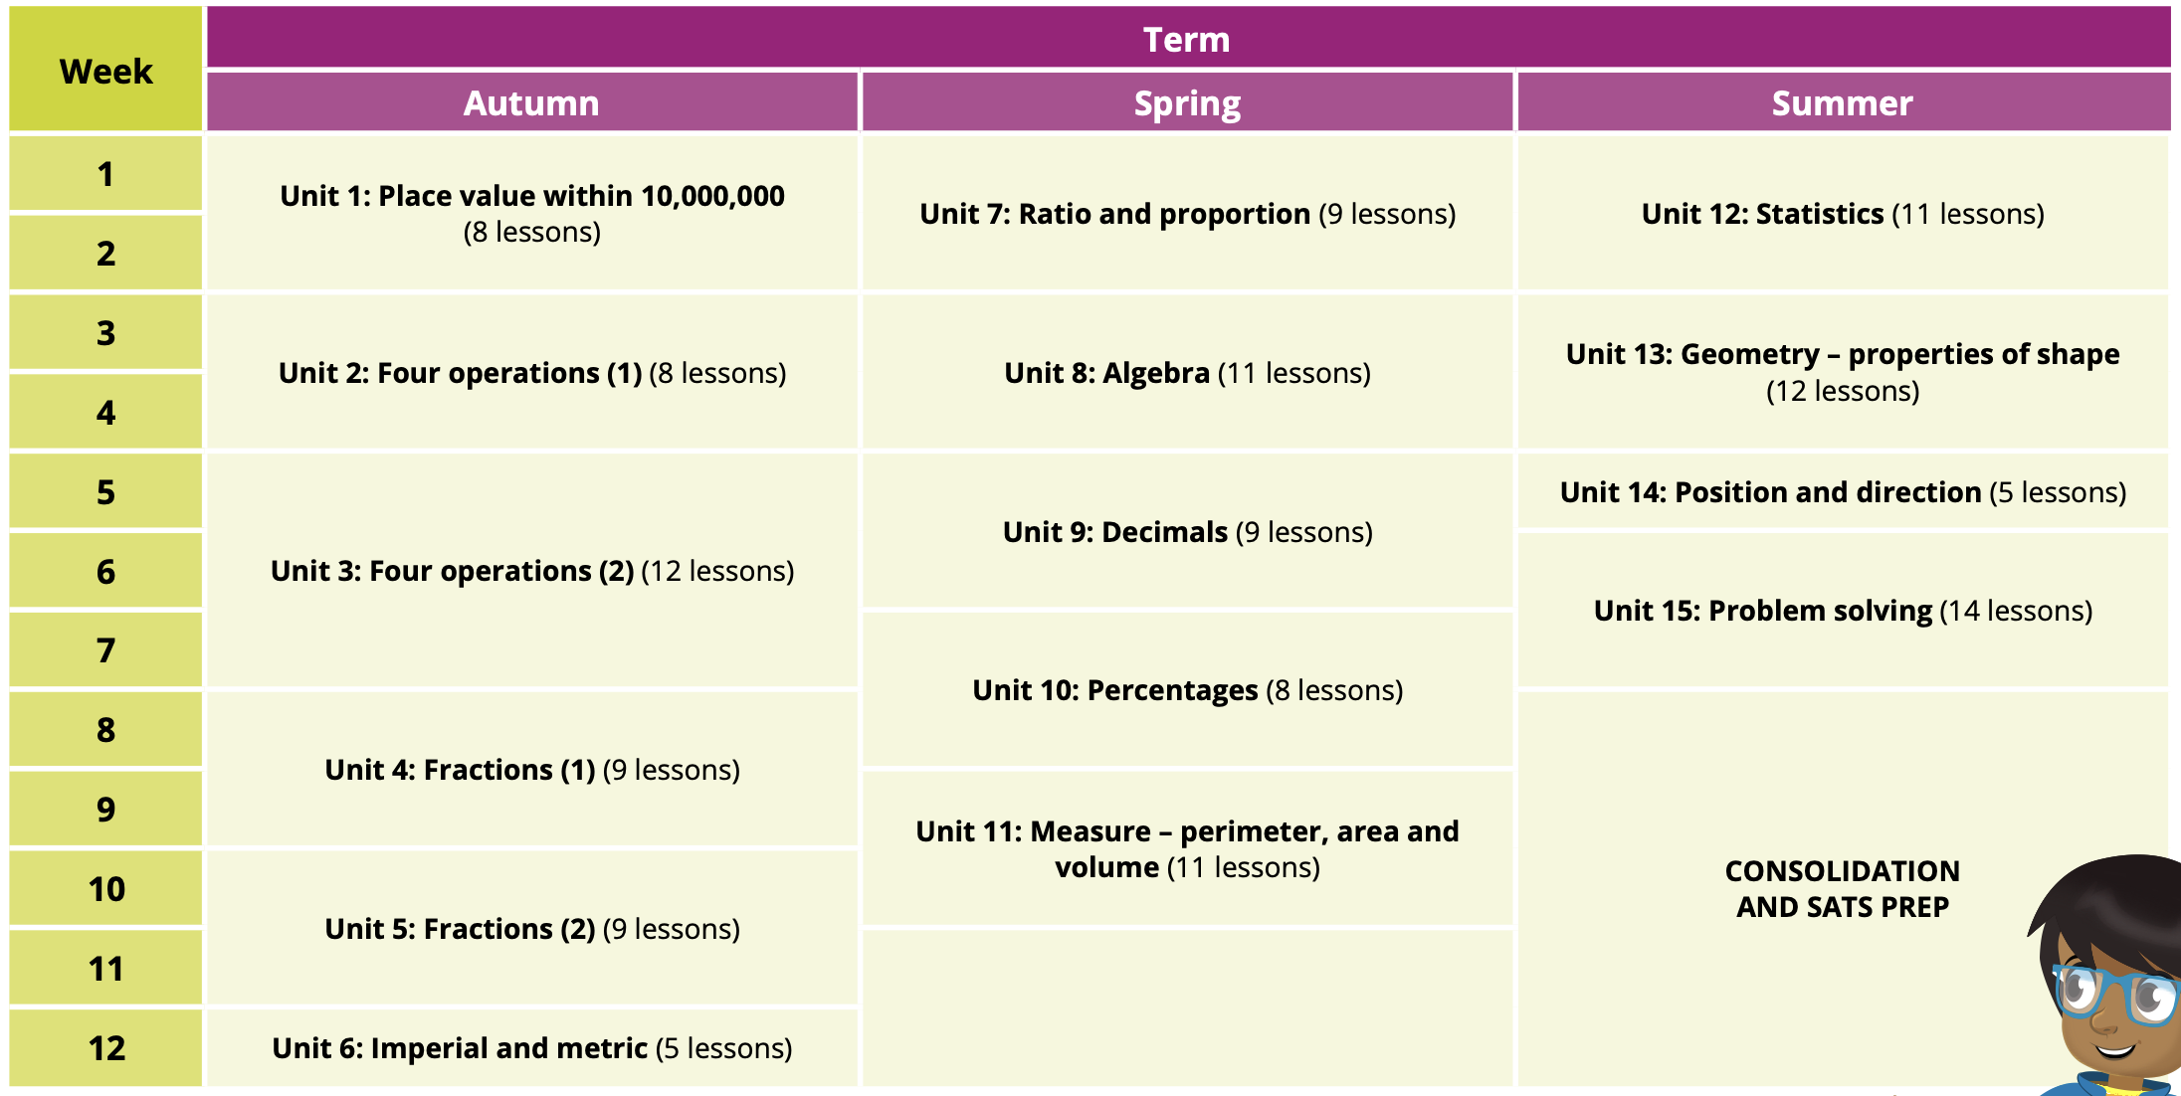
Y6 2025 - 2026
Maths Curriculum Overview

